Slide 1
Introduction to Critical Thinking
CE 4200
Professional Engineering Practice Issues
Spring 2022 Semester
William D. Lawson, PE, PhD

Slide 2
BASIS FOR THIS LECTURE
Introduction to Critical Thinking
CE 4200: Professional Engineering Practice Issues
Spring 2022 Semester
William D. Lawson, PE, PhD

Slide 3
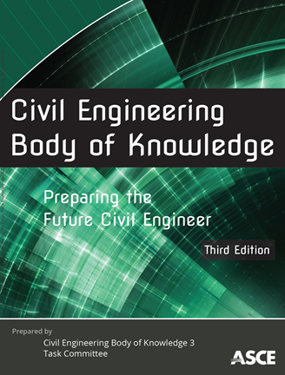
BOK3 Outcomes
Mathematics
Natural Sciences
Social Sciences
Humanities
Materials Science
Engineering Mechanics
Experimental Methods and Data Analysis
Critical Thinking and Problem Solving
Project Management
Engineering Economics
Risk and Uncertainty
Breadth in Civil Engr Areas
Design
Technical Depth
Sustainability
Communication
Teamwork and Leadership
Lifelong Learning
Professional Attitudes
Professional Responsibilities
Ethical Responsibilities

Slide 4
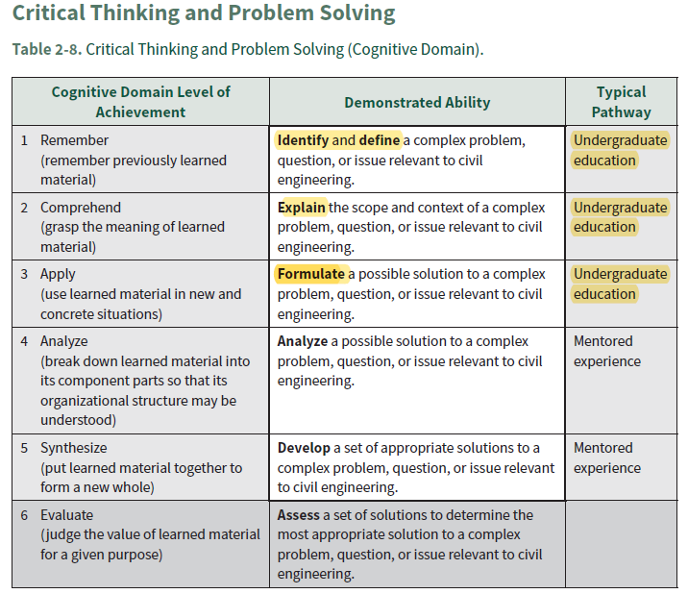
Critical thinking and Problem Solving CE BOK 3rd Edition

Slide 5
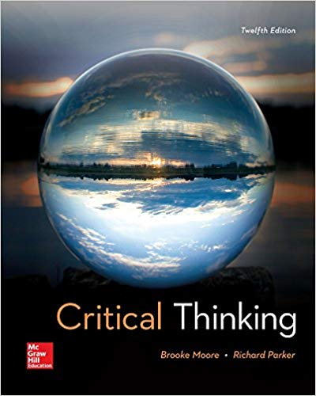
Critical Thinking Reference Textbook for a critical thinking course
Critical Thinking 12th Edition
Brooke Noel Moore
Professor
Department of Philosophy
California State University: Chico
Richard Parker
Professor Emeritus
Department of Philosophy
California State University: Chico
ISBN-13: 978-1259690877
Amazon
New… from $70.48
Used… from $49.03
Rent… from $26.74

Slide 6

Critical Thinking Reference CE BOK 3rd Edition
www.criticalthinking.org
The Foundation for Critical Thinking seek[s] to promote essential change in education and society through the cultivation of fairminded critical thinking.
Critical thinking requires the cultivation of core intellectual virtues such as intellectual humility, perseverance, integrity, and responsibility. Nothing of real value comes easily…

Slide 7
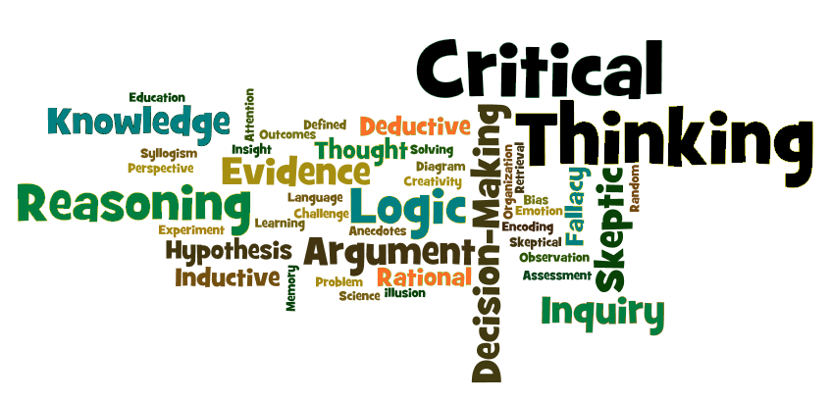
Judgment

Slide 8
SOME DEFINITIONS
Introduction to Critical Thinking
CE 4200: Professional Engineering Practice Issues
Spring 2022 Semester
William D. Lawson, PE, PhD

Slide 9
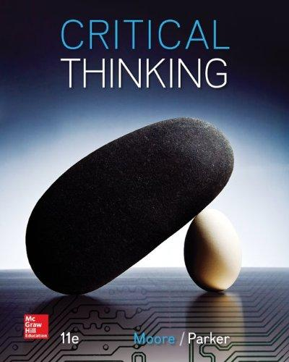
Critical Thinking… Definition
Critical thinking is the careful, deliberate determination of whether we should accept, reject, or suspend judgment about a claim – and of the degree of confidence with which we accept or reject it.
~ Moore & Parker

Slide 10
What do we mean by critical thinking?
Critical thinking means making reasoned judgments that are logical and well-thought out. It is a way of thinking in which you don't simply accept all arguments and conclusions you are exposed to but rather have an attitude involving questioning such arguments and conclusions.
~ Tara DeLecce

Slide 11
How do you define critical thinking?
"Critical thinking is the intellectually disciplined process of actively and skillfully conceptualizing, applying, analyzing, synthesizing, and/or evaluating information gathered from, or generated by, observation, experience, reflection, reasoning, or communication, as a guide to belief and action. In its exemplary form, it is based on universal intellectual values that transcend subject matter divisions: clarity, accuracy, precision, consistency, relevance, sound evidence, good reasons, depth, breadth, and fairness...”
~ Michael Scriven & Richard Paul

Slide 12
Conception of Critical Thinking
"Critical thinking is self-guided, self-disciplined thinking which attempts to reason at the highest level of quality in a fairminded way. People who think critically attempt, with consistent and conscious effort, to live rationally, reasonably, and empathically. They are keenly aware of the inherently flawed nature of human thinking when left unchecked…”
~ Linda Elder

Slide 13
What is the concept of critical thinking?
Critical thinking is that mode of thinking — about any subject, content, or problem — in which the thinker improves the quality of his or her thinking by skillfully analyzing, assessing, and reconstructing it. Critical thinking is self-directed, self-disciplined, self-monitored, and self-corrective thinking.
~ The Foundation for Critical Thinking

Slide 14
Consensus Statement Regarding Critical Thinking
We understand critical thinking to be purposeful, self-regulatory judgment which results in interpretation, analysis, evaluation, and inference, as well as explanation of the evidential, conceptual, methodological, criteriological, or contextual considerations upon which that judgment is based.
~American Philosophical Association Delphi Report (1990)

Slide 15
CHARACTERISTICS
Introduction to Critical Thinking
CE 4200: Professional Engineering Practice Issues
Spring 2022 Semester
William D. Lawson, PE, PhD

Slide 16

Student Exercise
“Think, Pair, Share”
Identify what YOU think are the characteristics of a critical thinker
Pair up with the person (or persons) near you and discuss your lists
Share observations with the class (instructor-guided)

Slide 17
Who is a critical thinker?
Critical thinking is the ability to think clearly and rationally about what to do or what to believe. It includes the ability to engage in reflective and independent thinking. Someone with critical thinking skills is able to do the following:
understand the logical connections between ideas
identify, construct and evaluate arguments
detect inconsistencies and common mistakes in reasoning
solve problems systematically
identify the relevance and importance of ideas
reflect on the justification of one's own beliefs and values
~Joe Lau & Jonathan Chan

Slide 18
The Ideal Critical Thinker
The ideal critical thinker is habitually inquisitive, well-informed, trustful of reason, open-minded, flexible, fair-minded in evaluation, honest in facing personal biases, prudent in making judgments, willing to reconsider, clear about issues, orderly in complex matters, diligent in seeking relevant information, reasonable in the selection of criteria, focused in inquiry, and persistent in seeking results which are as precise as the subject and the circumstances of inquiry permit.
~American Philosophical Association Delphi Report (1990)

Slide 19
What are characteristics of a critical thinker?
Strong critical thinkers demonstrate the following characteristics:
inquisitiveness with regard to a wide range of issues
concern to become and remain well-informed
alertness to opportunities to use critical thinking
self-confidence in one’s own abilities to reason
open-mindedness regarding divergent world views
flexibility in considering alternatives and opinions
understanding of the opinions of other people
fair-mindedness in appraising reasoning
honesty in facing one’s own biases, prejudices, stereotypes, or egocentric tendencies
prudence in suspending, making or altering judgments
willingness to reconsider and revise views where honest reflection suggests that change is warranted
~American Philosophical Association Delphi Report (1990)

Slide 20
What is the result of critical thinking?
A well-cultivated critical thinker:
Raises vital questions and problems, formulating them clearly and precisely
Gathers and assesses relevant information, using abstract ideas to interpret it effectively
Comes to well-reasoned conclusions and solutions, testing them against relevant criteria and standards
Thinks open-mindedly within alternative systems of thought, recognizing and assessing, as needs be, their assumptions, implications, and practical consequences
Communicates effectively with others in figuring out solutions to complex problems
~ The Foundation for Critical Thinking

Slide 21
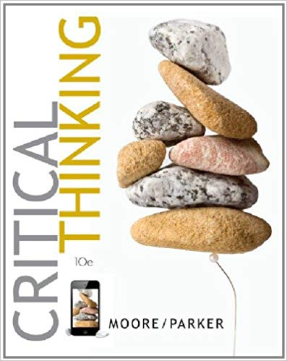
The Focus of Critical Thinking
Critical thinking includes a variety of deliberative processes aimed at making wise decisions about what to believe and do, processes that center on evaluation of arguments...
~Moore & Parker

Slide 22
A BRIEF HISTORY
Introduction to Critical Thinking
CE 4200: Professional Engineering Practice Issues
Spring 2022 Semester
William D. Lawson, PE, PhD

Slide 23
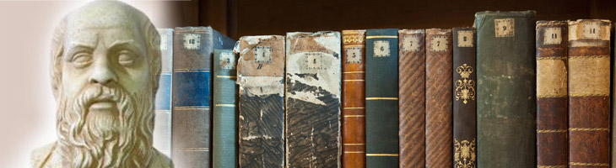
Roots of Critical Thinking
The intellectual roots of critical thinking are as ancient as its etymology, traceable, ultimately, to the
teaching practice and vision of Socrates 2,500 years ago who discovered by a method of probing questioning that people could not rationally justify their confident claims to knowledge. Confused meanings, inadequate evidence, or self-contradictory beliefs often lurked beneath smooth but largely empty rhetoric.
~ The Foundation for Critical Thinking

Slide 24
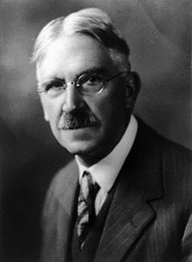
Who is considered the father of modern day critical thinking?
The philosopher John Dewey, often considered the father of modern day critical thinking, defines critical thinking as: “Active, persistent, careful consideration of a belief or supposed form of knowledge in light of the grounds that support it and the further conclusions to which it tends” (Dewey, 1933, p. 9).
John Dewey, 1859-1952

Slide 25
The Collective Contribution of the History of Critical Thought
The basic questions of Socrates can now be much more powerfully and focally framed and used. In every domain of human thought… it is now possible to question:
ends and objectives,
the status and wording of questions,
the sources of information and fact,
the method and quality of information collection,
the mode of judgment and reasoning used,
the concepts that make that reasoning possible,
the assumptions that underlie concepts in use,
the implications that follow from their use, and
the point of view or frame of reference within which reasoning takes place

Slide 26
THE CRITICAL THINKING PROCESS
Introduction to Critical Thinking
CE 4200: Professional Engineering Practice Issues
Spring 2022 Semester
William D. Lawson, PE, PhD

Slide 27
What is the critical thinking model?
Critical thinking is that mode of thinking – about any subject, content, or problem — in which the thinker improves the quality of his or her thinking by skillfully taking charge of the structures inherent in thinking and imposing intellectual standards upon them.
~ The Foundation for Critical Thinking

Slide 28
What are the six steps of critical thinking?
Step 1: ORGANISE INFORMATION. We have no difficulty in locating information. ...
Step 2: STRUCTURE REASONING. ...
Step 3: CONSIDER EVIDENCE. ...
Step 4: IDENTIFY ASSUMPTIONS. ...
Step 5: EVALUATE ARGUMENTS. ...
Step 6: COMMUNICATE CONCLUSION.

Slide 29
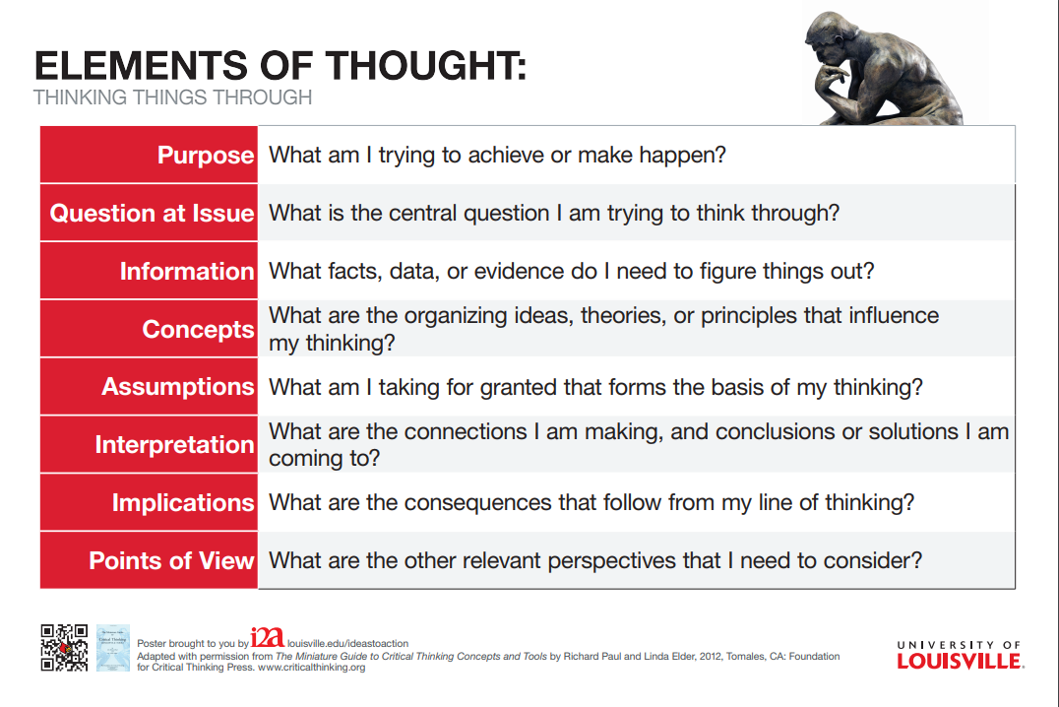

Slide 30
What are the 7 critical thinking skills?
Analyzing. Separating or breaking a whole into parts to discover their nature, functional and relationships. ...
Applying Standards. ...
Discriminating. ...
Information Seeking. ...
Logical Reasoning. ...
Predicting. ...
Transforming Knowledge.

Slide 31
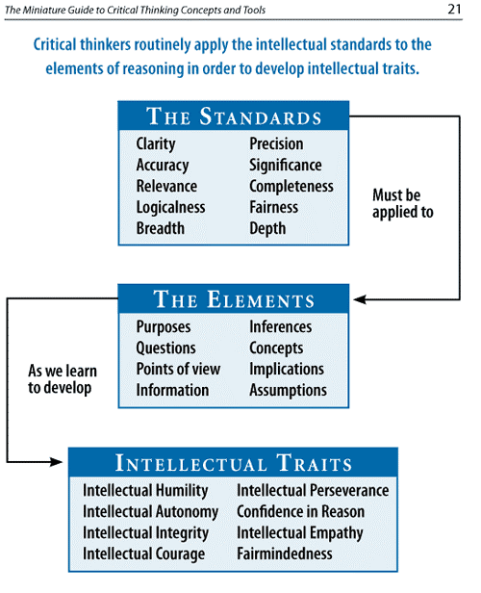
The evaluation of our thinking as engineers requires a vocabulary of thinking and reasoning. The intellect requires a voice.
Richard Paul and Linda Elder, from the Foundation for Critical Thinking, have proposed a critical thinking model documented in various sources…
Source: Applied Disciplines: A Critical Thinking Model for Engineering by R. J. Niewoehner, United States Naval Academy, USA

Slide 32
How do you practice critical thinking?
Ask Basic Questions. “The world is complicated. ...
Question Basic Assumptions. ...
Be Aware of Your Mental Processes. ...
Try Reversing Things. ...
Evaluate the Existing Evidence. ...
Remember to Think for Yourself. ...
Understand That No One Thinks Critically 100% of the Time.

Slide 33
Student Exercise Practice your critical thinking problem solving and communication skills
RESPOND TO THE FOLLOWING:
Sociologist Erving Goffman has pointed out that all social groups, including professions, develop a protective attitude toward members of their group, even when what some of the members do is seen as morally wrong. A sense of loyalty to the group often overrides what they would otherwise deem immoral.
Consider the arguments for and against exposing people with whom you are personally close or with whom you have close professional ties. Develop a position on this issue that could serve as a guide for anyone in such a position.

Slide 34
The Analysis and Assessment of Thinking
To develop as fair-minded critical thinkers, students need to be able to assess… thinking, as follows:
All reasoning has a PURPOSE
All reasoning is an attempt to FIGURE SOMETHING OUT, TO SETTLE SOME QUESTION, TO SOLVE SOME PROBLEM
All reasoning is based on ASSUMPTIONS
All reasoning is done from some POINT OF VIEW
All reasoning is based on DATA, INFORMATION, AND EVIDENCE
All reasoning is expressed through, and shaped by, CONCEPTS and IDEAS
All reasoning contains INFERENCES or INTERPRETATIONS by which we draw CONCLUSIONS and give meaning to data
All reasoning leads somewhere, has IMPLICATIONS and CONSEQUENCES

Slide 35
What are the core critical thinking skills?
Core critical thinking skills include analysis, interpretation, inference, evaluation, explanation, and self-reflection. These skills are central to problem solving and decision making in an extremely wide variety of contexts and at all educational and professional levels.
~Dr. Peter Facione/ Insight Assessment FAQs

Slide 36
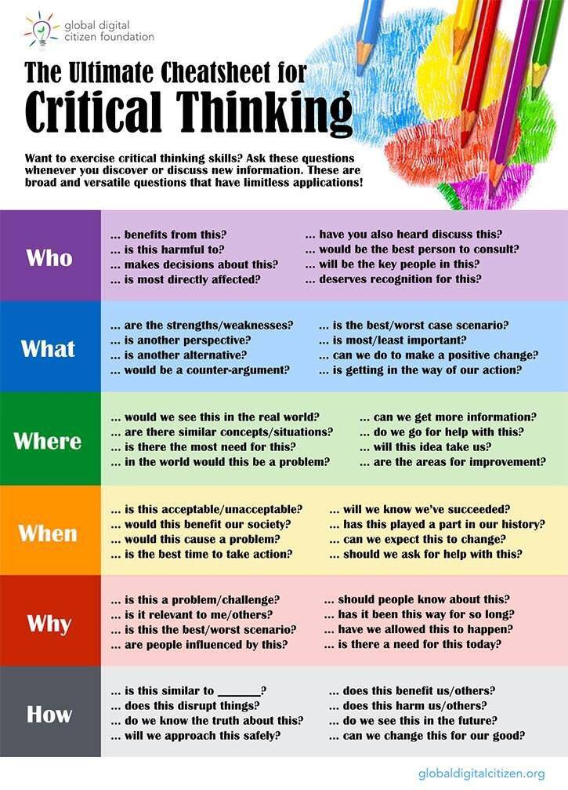
The Critical Thinking Skills Cheatsheet [Infographic]
by Lee Watanabe-Crockett
Dec 12, 2016 | Critical Thinking
Source: The Global Digital Citizen Foundation
https://globaldigitalcitizen.org

Slide 37
GROWTH IN CRITICAL THINKING
Introduction to Critical Thinking
CE 4200: Professional Engineering Practice Issues
Spring 2022 Semester
William D. Lawson, PE, PhD

Slide 38
Critical Thinking Development: A Stage Theory Linda Elder with Richard Paul
The stages we will lay out are as follows:
Stage One: The Unreflective Thinker.
Stage Two: The Challenged Thinker.
Stage Three: The Beginning Thinker.
Stage Four: The Practicing Thinker.
Stage Five: The Advanced Thinker.
Stage Six: The Accomplished Thinker.

Slide 39
What is an unreflective thinker?
Unreflective thinkers are largely unaware of the determining role that thinking is playing in their lives and of the many ways that problems in thinking are causing problems in their lives. Unreflective thinkers lack the ability to explicitly assess their thinking and improve it thereby.

Slide 40
What is a beginning thinker?
When a person actively decides to take up the challenge to grow and develop as a thinker, that person enters the stage we call "beginning thinker." This is the stage of thinking in which one begins to take thinking seriously. This is a preparatory stage before one gains explicit command of thinking.

Slide 41
What is the practicing thinker?
Stage Four: The Practicing Thinker—Good Thinking Can Be Practiced Like Basketball, Tennis, or Ballet. ... When people explicitly recognize that improvement in thinking requires regular practice, and adopt some regimen of practice, then, and only then, have they become what we call "practicing thinkers."

Slide 42
How can students improve critical thinking skills?
7 Steps to Improving Your Critical Thinking
Don't Take Anything at Face Value. The first step to thinking critically is to learn to evaluate what you hear, what you read, and what you decide to do.
Consider Motive. ...
Do Your Research. ...
Ask Questions. ...
Don't Assume You're Right. ...
Break It Down. ...
Keep It Simple.

Slide 43
ASSESSMENT OF CRITICAL THINKING
Introduction to Critical Thinking
CE 4200: Professional Engineering Practice Issues
Spring 2022 Semester
William D. Lawson, PE, PhD

Slide 44
What is a critical thinking test?
Critical thinking tests measure an individual's ability to make analyse, conceptualise and reason effectively. Critical thinking tests can measure critical thinking in a number of ways, and critical thinking tests often comprise multiple different sub-tests within a single test.

Slide 45
INTERNATIONAL CRITICAL THINKING BASIC CONCEPTS & UNDERSTANDING ONLINE TEST Test developed by Dr. Linda Elder, Dr. Richard Paul, and Dr. Rush Cosgrove
The test measures the extent to which students, faculty, or indeed anyone, understand the fundamental concepts embedded in critical thinking. A high score provides evidence of the person having done some critical thinking about critical thinking.
It focuses on the five essential dimensions of critical thinking: 1. the analysis of thought. 2. the assessment of thought 3. the dispositions of thought 4. the skills and abilities of thought 5. the obstacles or barriers to critical thought

Slide 46
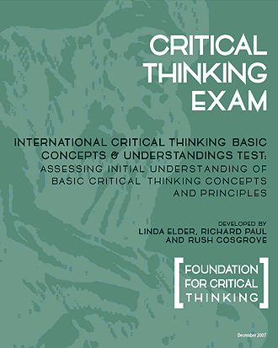
Basic Concepts Sample Test
The Critical Thinking Basic Concepts & Understandings Sample Test is now available online to all members of the Critical Thinking Community.
The sample test is intended for use as a demonstration of both the content and grading tools which are available in the full version of this test. The sample test has a limited number of questions compared to the full version, therefore it should not be used for assessment purposes

Slide 47
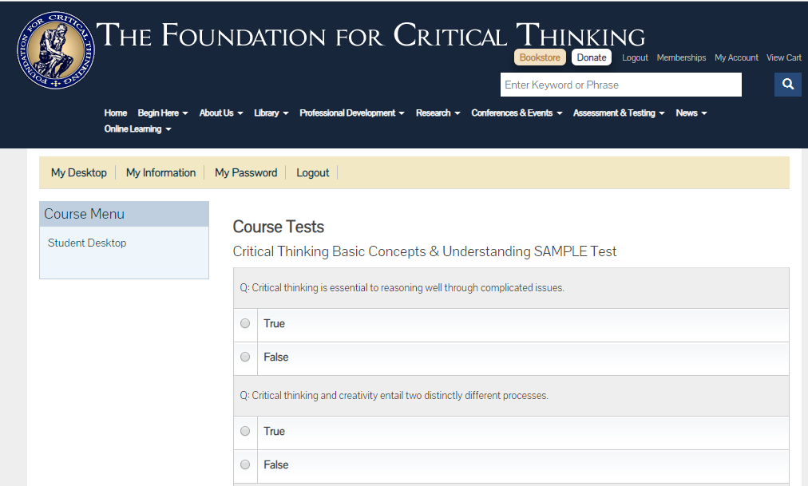

Slide 48
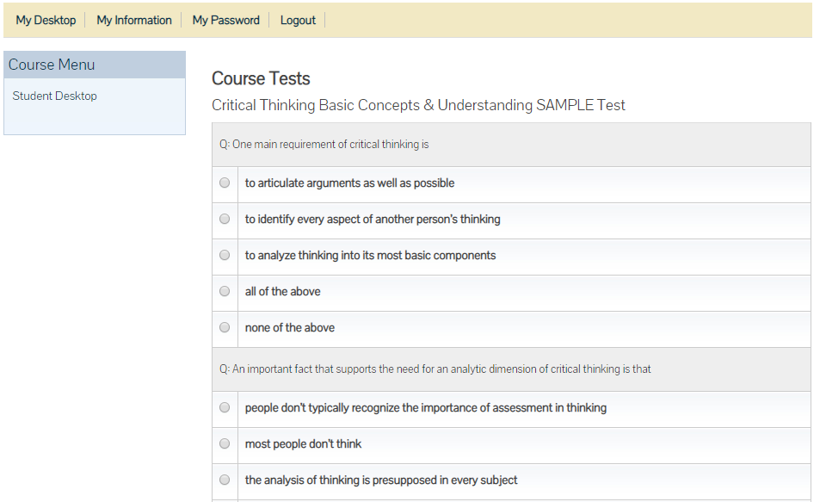

Slide 49
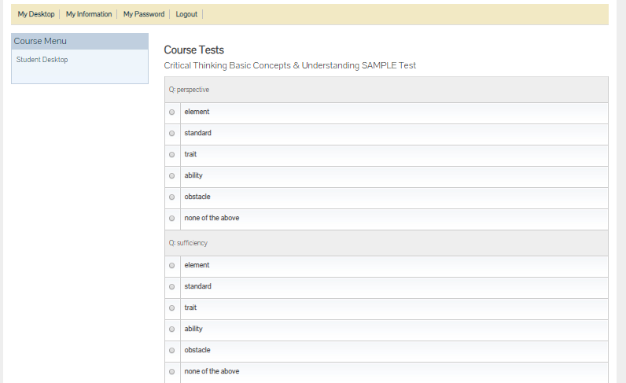

Slide 50


